Slide 1
Survey of FSHD patients’ views and priorities
ENMC Workshop: A global FSHD registry framework
June Kinoshita Executive Director, FSH Society Representing FSHD Champions
November 19, 2016

Slide 2
FSHD patient survey
Survey designed to assess patients’ basic knowledge of registries, their personal interactions with them, and what they want to learn from registries.
Sent to ~3,000 patients and family members in FSH Society’s member database.
326 responses received.

Slide 3
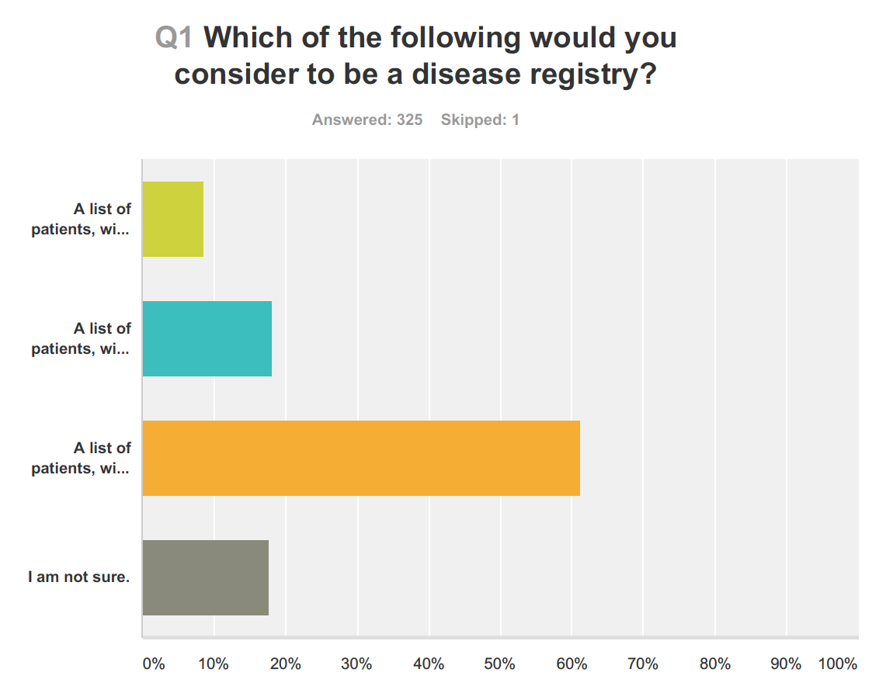
A list of patients, with names and contact information (e.g. address) ONLY
All of the above plus age, demographic information, and health/disease status
All of the above plus updates of disease progression

Slide 4
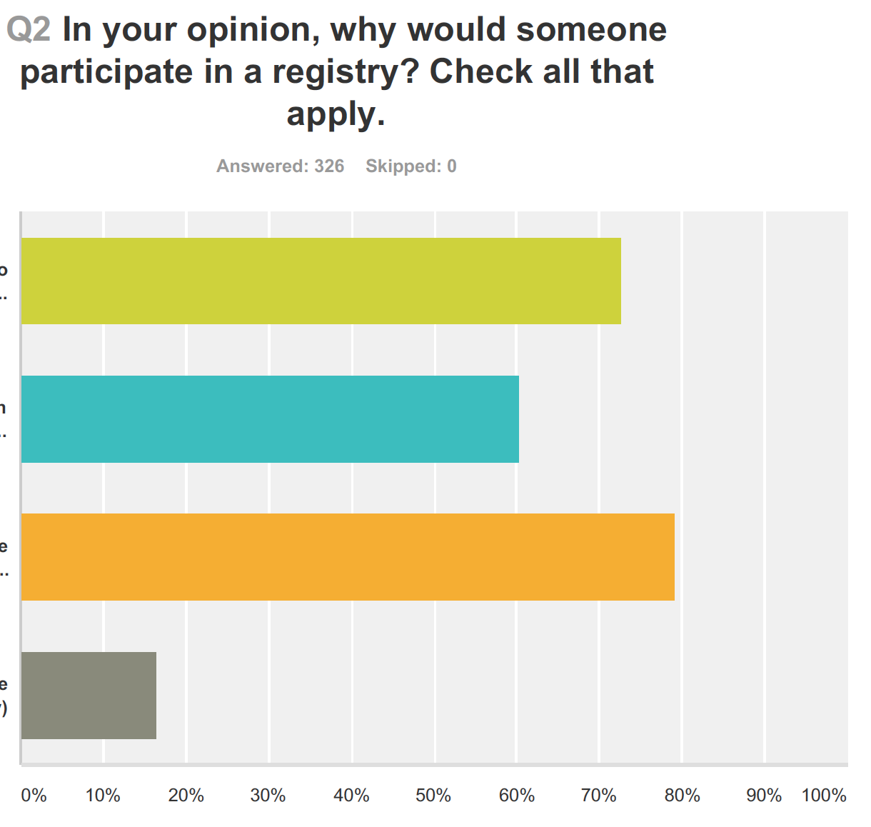
To keep up to date about new treatment and care options
To obtain information that will help delay the progression of the disease
To improve understanding of the disease and of treatment
Other

Slide 5
Responses to question: Why would someone participate in a registry?
Help scientists find right candidates for clinical trials or do data mining
To learn of clinical trials early to hopefully have a better chance of volunteering to participate.
Creates an opportunity to find individuals dealing with similar circumstances. Potential to build community and support
I am currently a member of a registry but have not really benefited from the annual questionnaires I am asked to complete.
I don't want to register for something that I get no information from. The registry should not only be for researchers but should provide information to patients.

Slide 6
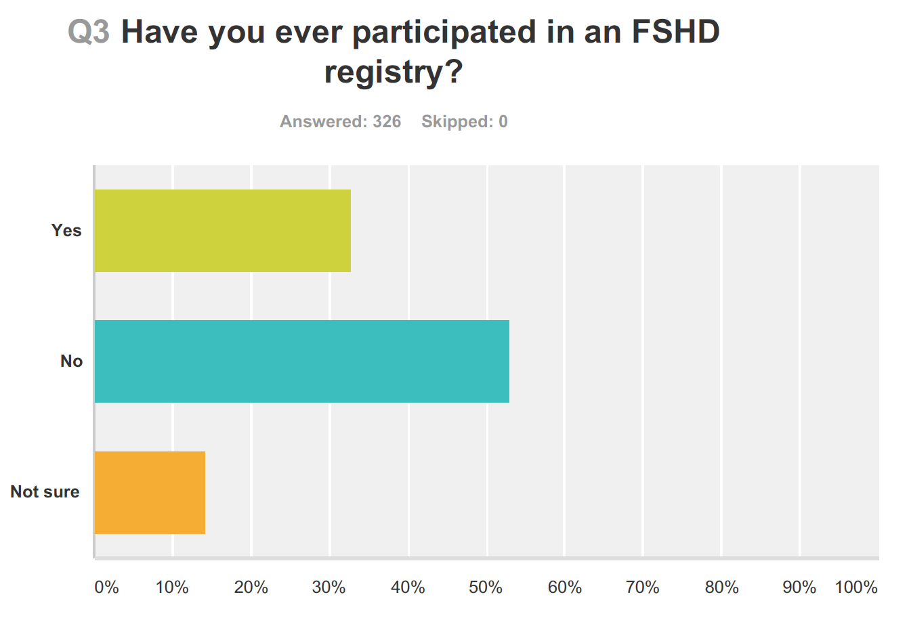

Slide 7
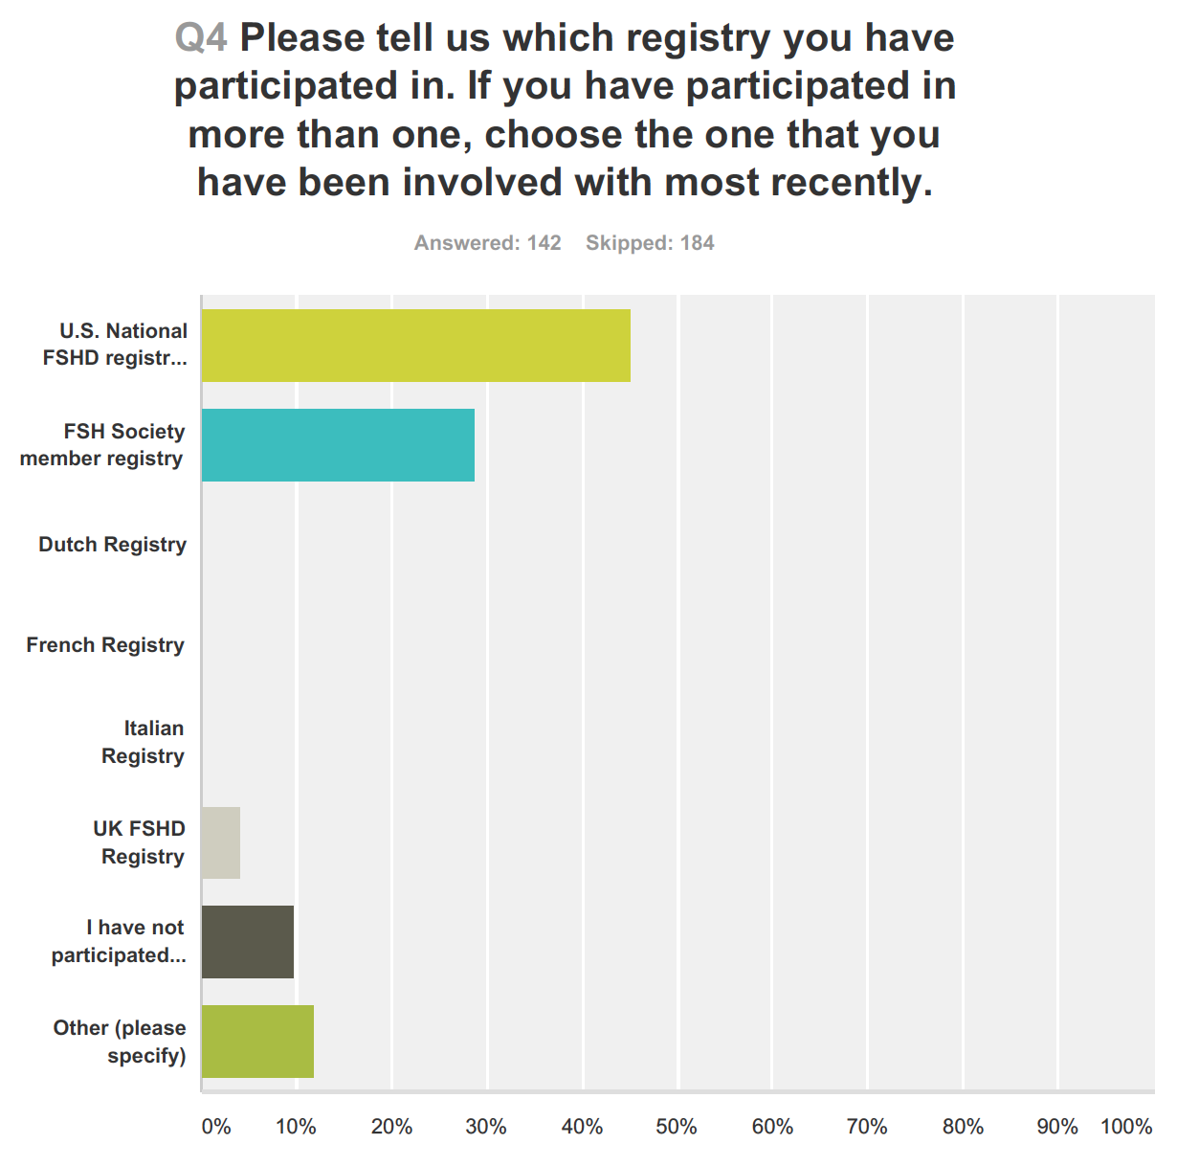

Slide 8
Responses to question: Which registry have you participated in?
I donated tissue, etc to the Johns Hopkins FSH program, but am not sure whether that put me in a registry.
I think I'm part of a neuromuscular registry in Canada.
I don't know if I am on any registries and I don't know where or how to verify.
I began getting registered on a "national" registry since a patient at Ohio State in 1992. Since then it seems every 2-3 years I am told of a new and exciting registry that I will be added to through Ohio State and I always wonder what happened to my name when it was added to the last registry? Why are there always NEW registries?

Slide 9
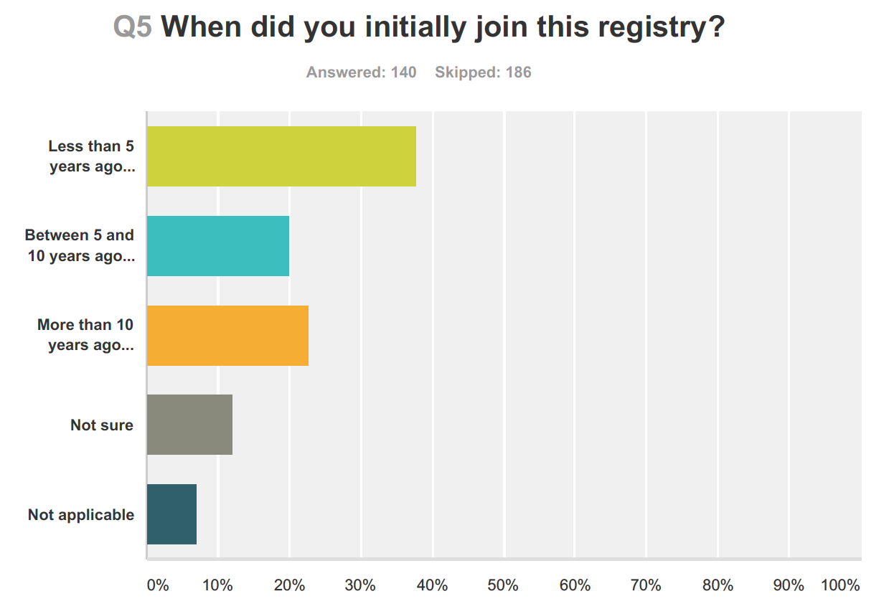

Slide 10
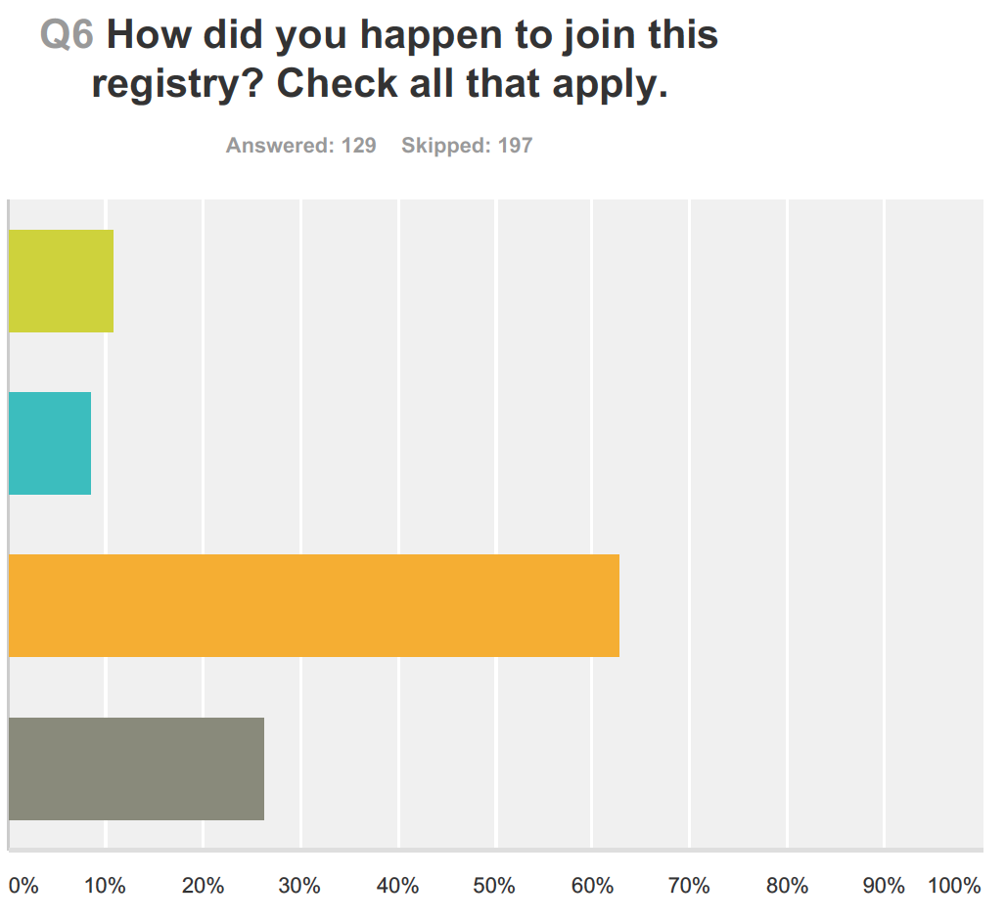
Direct request from a physician
Through a hospital or institution that I attend
Through an organization that deals with FSHD
Other

Slide 11
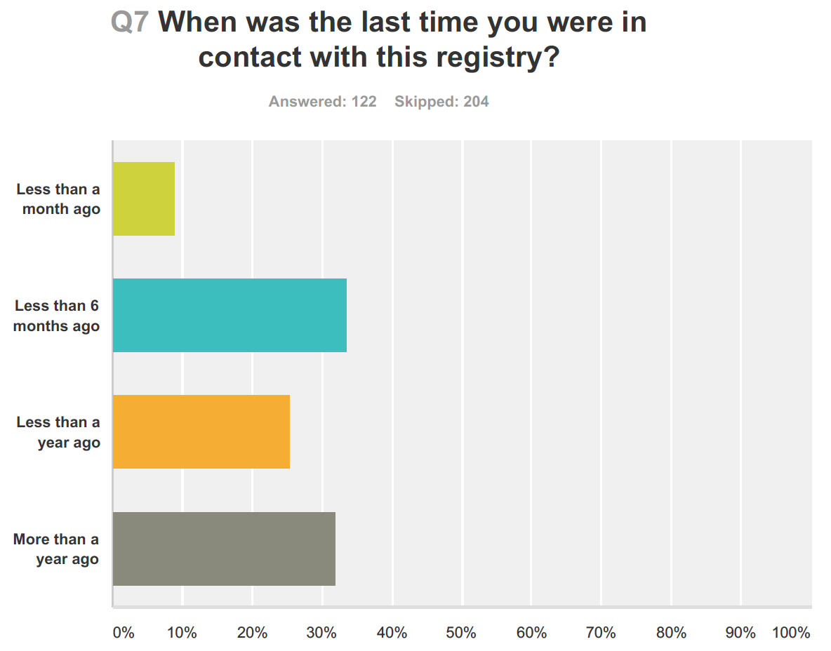

Slide 12
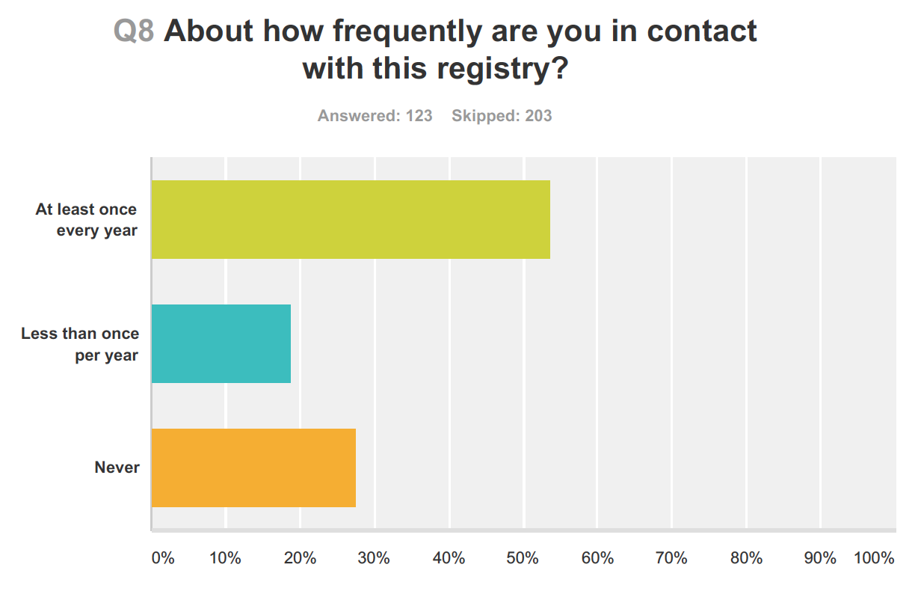

Slide 13
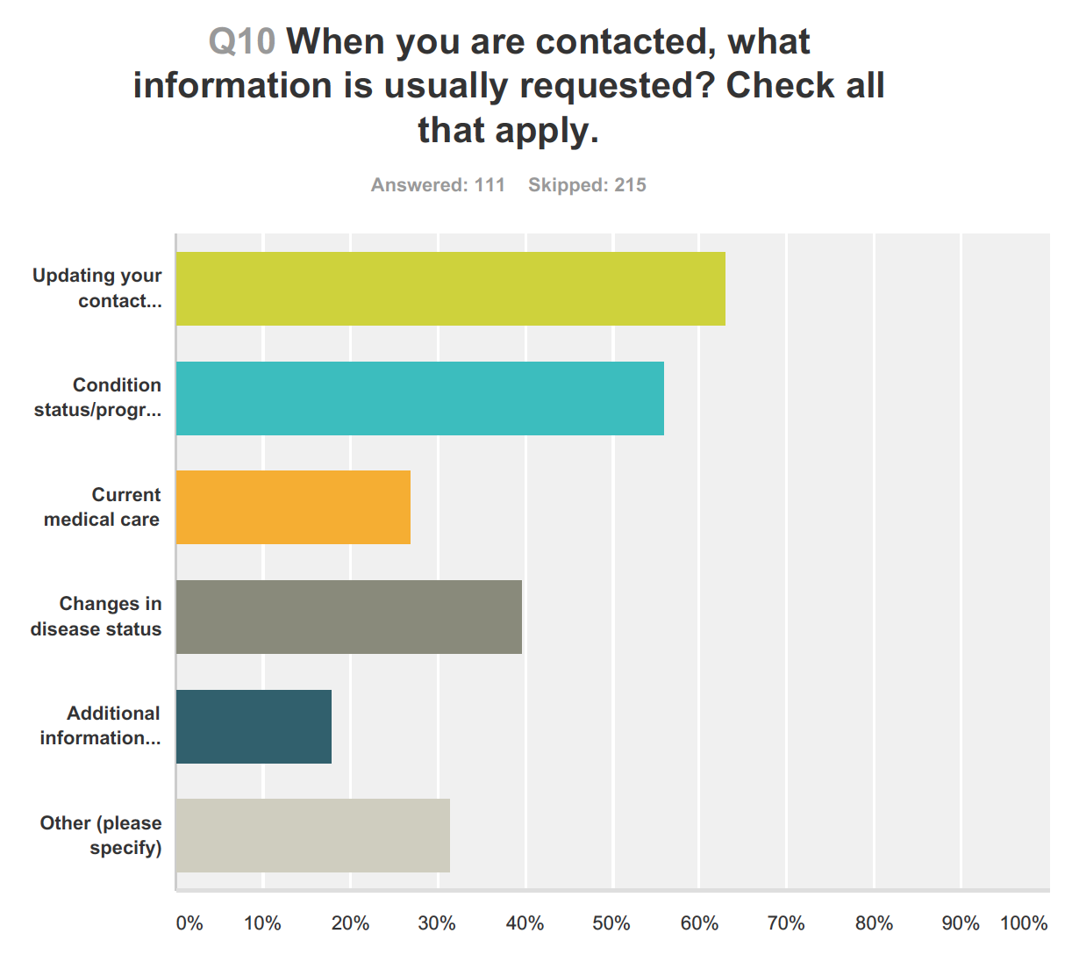
Additional information about neuromuscular disease in my family

Slide 14
Responses to question: When you are contacted, what information is usually requested?
The annual University of Rochester annual update is the form I fill out.
Limited Status update (and extremely rare volunteer or data-sharing opportunities)
I am never contacted.
I'm not sure if I'm in a registry or not.

Slide 15
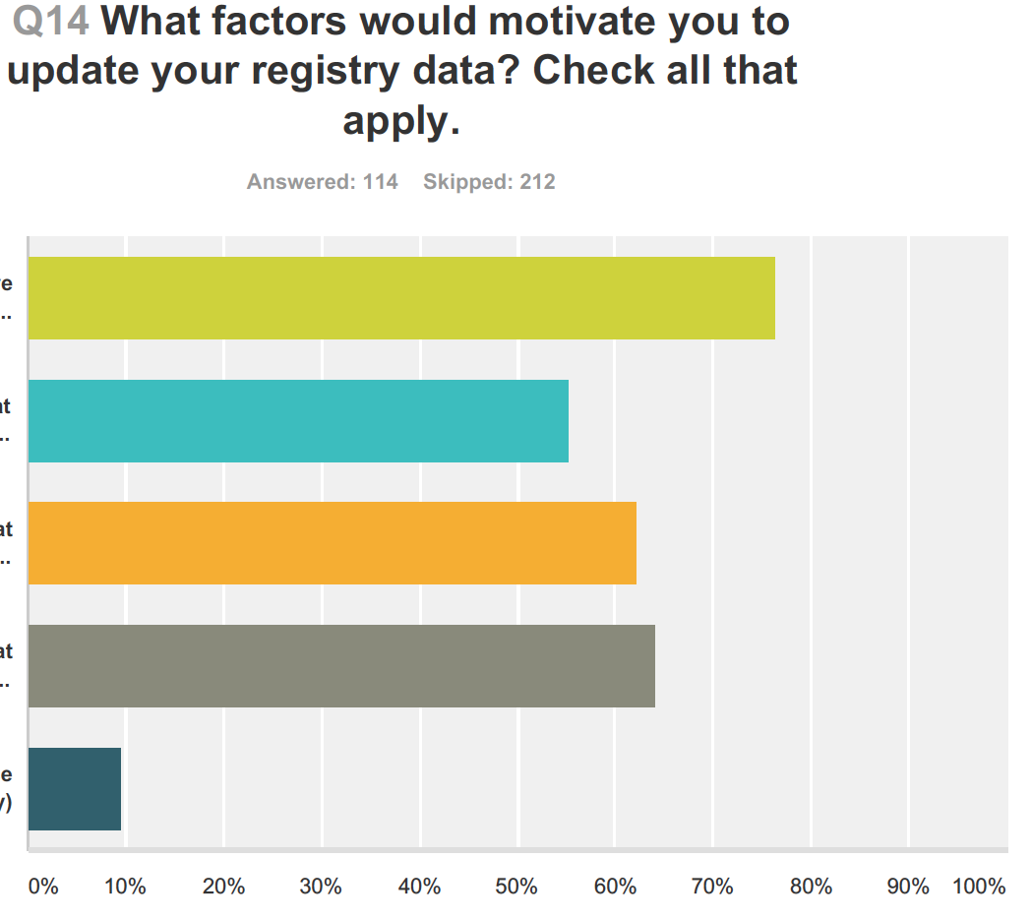
I receive reminders from the registry
I feel the registry is providing essential health & research findings
I feel the data could help me or my family members
I feel the data will help future generations
Other

Slide 16
Responses to question: What factors would motivate you to update registry data?
Aggregate data compiled from sufferers of the disease can provide meaningful statistics about prevalence, severity, and demographic data which can then be used to develop treatments/interventions.
If I could know that my data was available internationally and would reach researchers who might be looking for people with my particular circumstances.
If the information requests were electronic. I can't manage paper.

Slide 17
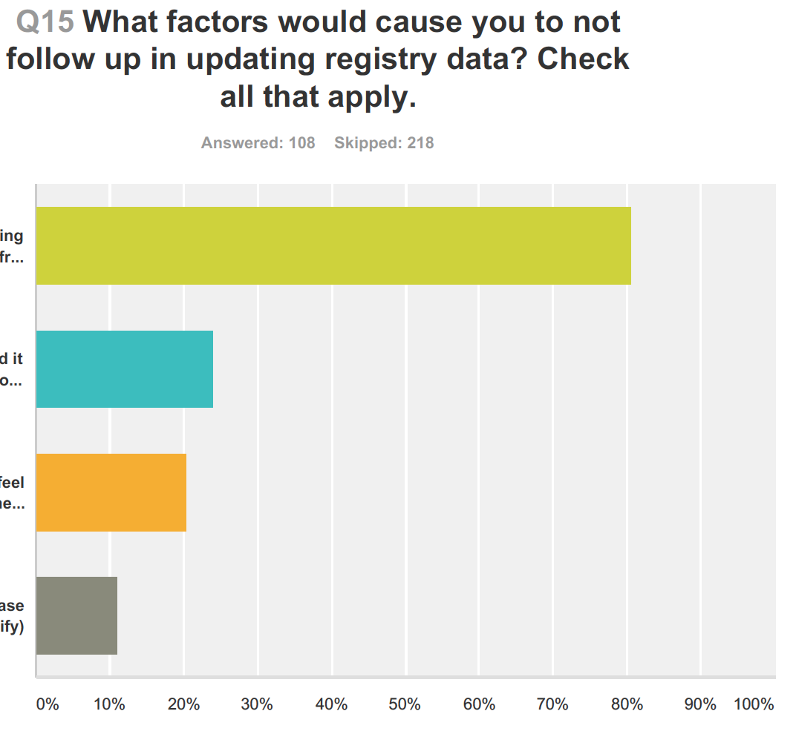
Not receiving reminders from the registry
I find it difficult to submit data that must be generated by my physician or healthcare provider
I don’t feel the data will help me or my family
Other

Slide 18
Responses to question: What factors would cause you not to follow up in updating registry data?
Tedious paperwork.
It would be nice to have a centralized real-time source, rather than going on clinicalstrial.gov every so often. An email update would be great.
Not knowing where or how to do it.

Slide 19
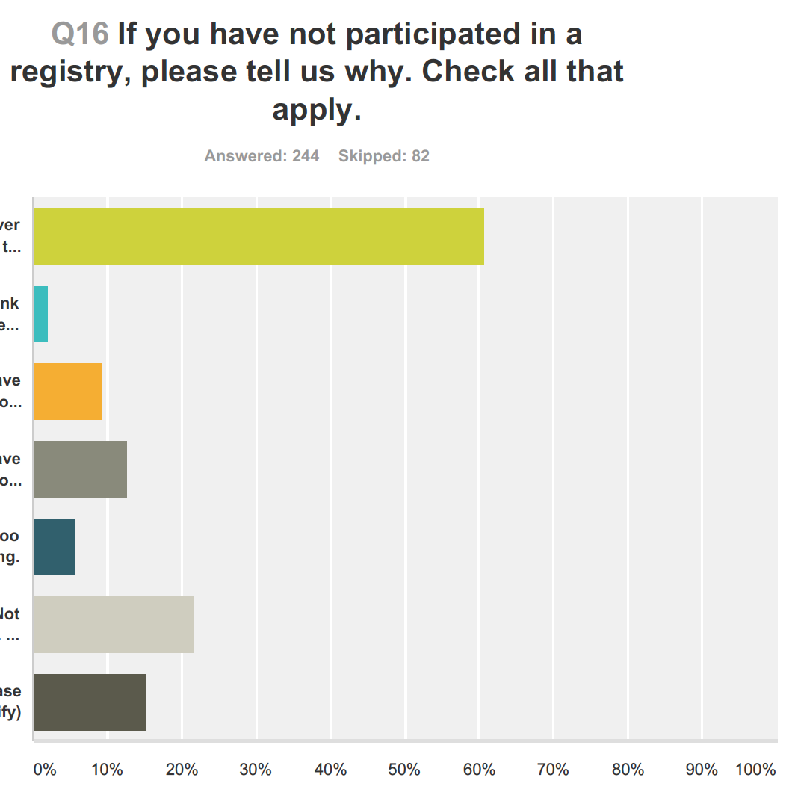
I have never been asked to participate
I didn’t think it would be helpful to research
I have concerns about medical privacy
I have concerns about how my information will be used
It seemed too time-consuming
Not applicable. I am participating in a registry
Other

Slide 20
Responses to question: If you have not participated in a registry, please tell us why.
I would be happy to participate if asked.
My participation is minimal because I feel I have few updates to provide which are meaningful.
I haven't had the genetic test done which made me ineligible for the only registry I know about.
A lot of the research that is available is based on muscle biopsies and I feel they are too invasive and painful .
Did not know enough how to get involved or where to start.
I participated in a registry for many years. I never received information regarding research projects, never saw a call for potential participants. I eventually stopped returning the questionnaire.

Slide 21
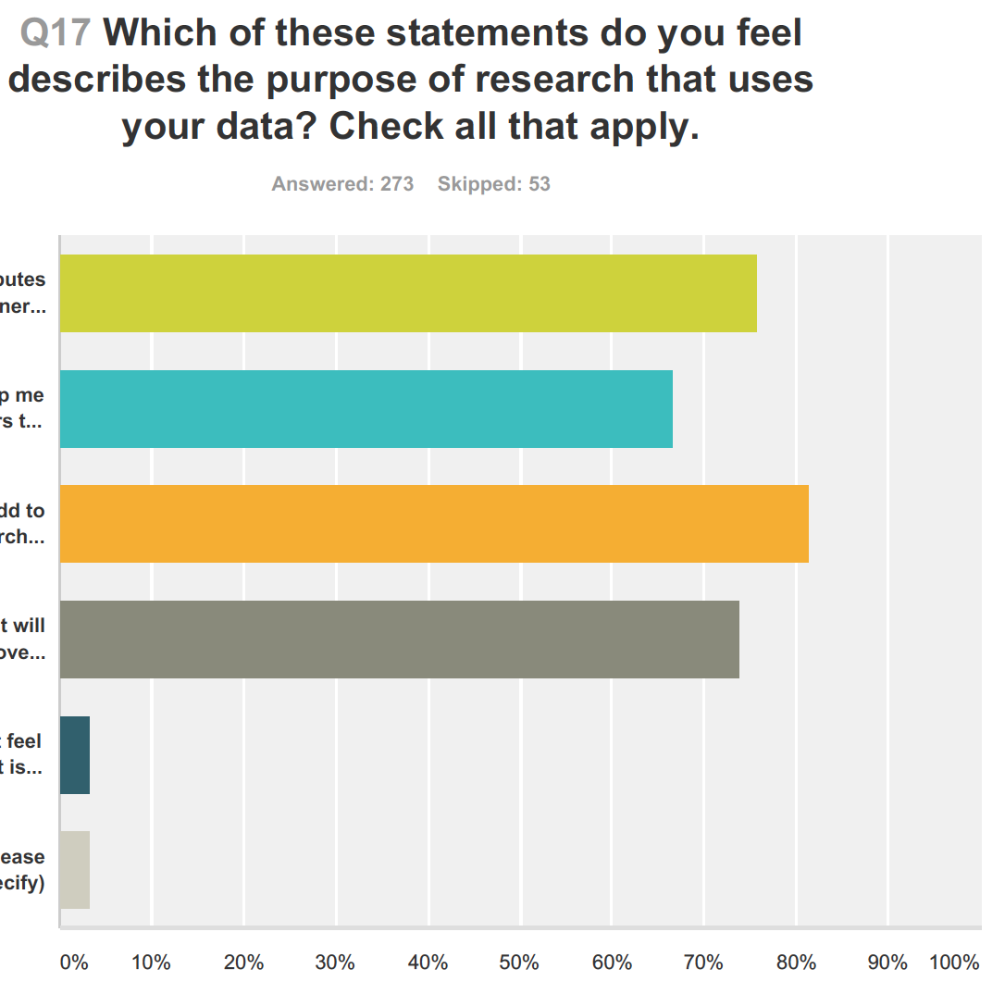
It contributes to our general knowledge of FSHD
It may help me and others to deal with the disease
It will add to the research knowledge about FSHD
It will improve care/treament of FSHD
I do not feel that it is particularly useful
Other

Slide 22
Responses to question: What is the purpose of a registry?
Throughout my wife's illness, we had no information available about the course of the disease and never really knew what to expect. I think that a registry could have provided a source of reliable information that we could have used to make better decisions and deal with the realities of the disease.

Slide 23
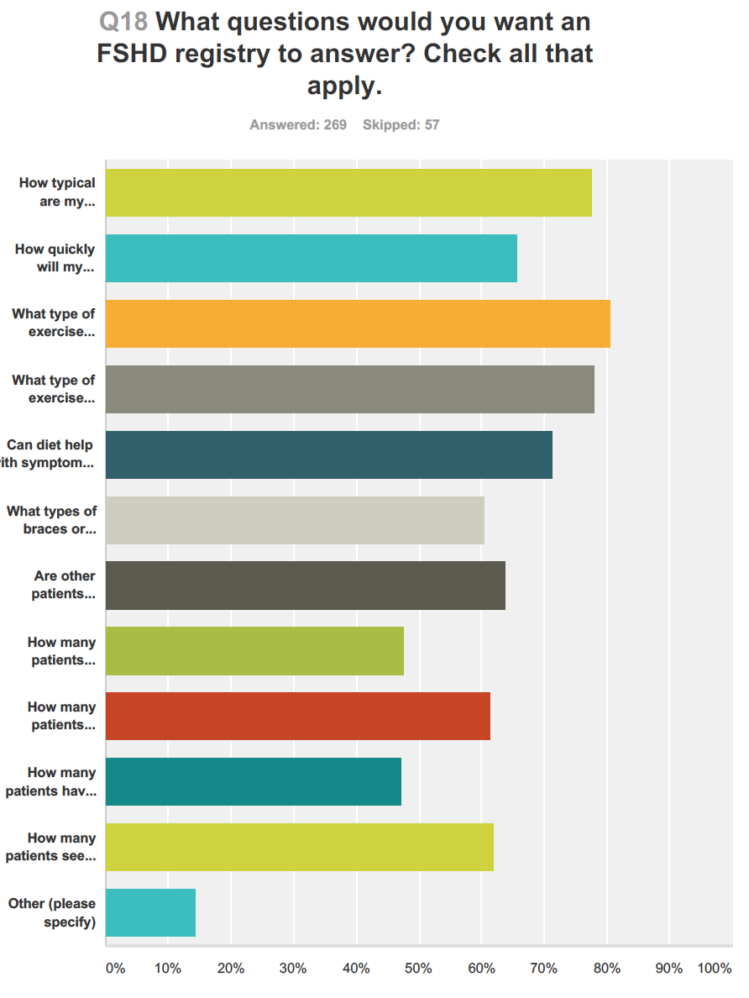
How typical are my symptoms?
How quickly will my symptoms get worse?
What type of exercise appears to be helpful?
What type of exercise appears to be harmful?
Can diet help with symptoms or slow the progression?
What types of braces or mobility devices are most useful?
Are other patients finding effective ways to manage pain?
How many patients experience hearing loss?
How many patients experience sleep and breathing issues?
How many patients have had scapular surgery, what was the outcome?
How many patients see large variation in symptoms and age of onset in their families?
Other

Slide 24
Responses to question: What questions do you want a registry to answer?
How does deletion size influence severity of disease?
How does FSHD affect incontinence and bowel issues?
How does infantile onset FSHD affect children's ability to reach adulthood and what is the quality of life they have?
Are there correlations of FSHD with symptoms not usually associated with it: digestive issues, immune system problems, heart, lung, kidney, liver issues, etc.?
What clinics are there with clinicians who have experience with many FSHD patients and provide a high standard of care?

Slide 25
Patient perspectives: What would improve the experience?
Being able to complete the surveys online.
Explain research aims and findings in lay language.
Include unaffected family members and map family pedigrees to investigate how FSHD varies among genetically related individuals, also across generations.
“Develop the questions to make the data more useful in terms of living with the condition.”
Provide a unified rather than fragmented experience for the patient, e.g. a single portal, clear explanations, integrate registry and study participation experience.

Slide 26
Patient advocacy perspective
Regular communication from registries will help keep patients engaged.
Involve patients in developing survey questions and improving the “user experience”.
Include patient reported data alongside clinician reported data for greater engagement and scalability.
Include advocacy groups, patients and family members in registry governance.
Ideally, work toward a single global registry with country or organization portals, integration with research studies, greater clarity.

Slide 27
Thank you www.fshdchampions.org

