Slide 1
Current Research in FSHD at UCD
Lisa Williams, MD
Neuromuscular Medicine Fellow, PGY6
UC Davis Neuromuscular Research Fellow
Notes:
And I have also had the opportunity to be menoDr. Day at Stanford during my residency training in the early stages of my career, so I feel very fortunate to have had that experience as well.

Slide 2
Objectives:
Introduction to UC Davis Health Neuromuscular Medicine Program
1
Describe how stereocamera kinect systems are designed and used in FSHD research at UC Davis
2
Describe FSHD Clinical Trials at UC Davis: Acceleron (ACE-083)
3

Slide 3
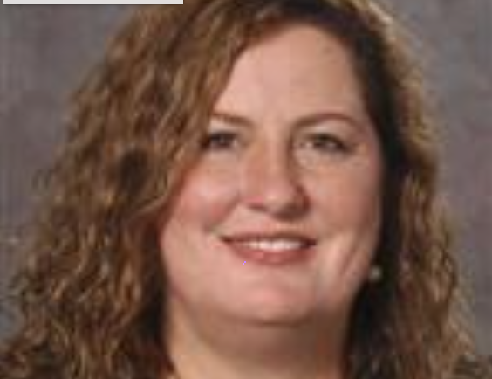
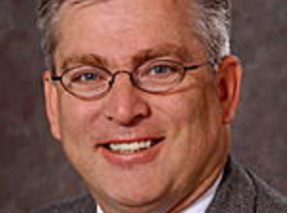
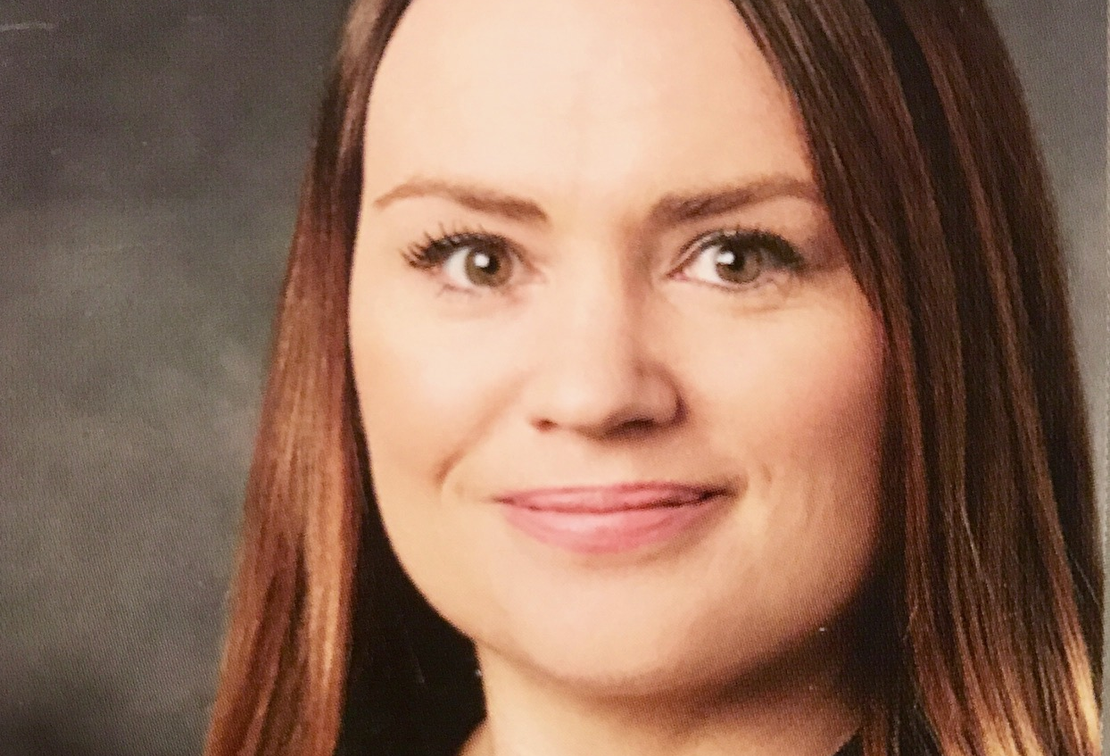
To improve the health, function and quality of life of individuals with acute and chronic musculoskeletal conditions, brain and spinal cord insults, and neuromuscular disorders..
Our Mission
Notes:
I would like to take a moment to introduce our department of doctors and physicians. But before doing that, I would like to share with you our Mission at UC Davis Department of PM&R.
We are the only Neuromuscular Medicine program in the country housed within the department of PM&R and collectively we are dedicated to the management and treatment of patients with neuromuscular disease both clinically and in the realm of research.
Erik Henrickson, PhD, MPH: Over the past 17 years Dr. Henricson served first as co-director of the 25-site Cooperative International Neuromuscular Research Group (CINRG) (www.cinrgresearch.org) and then as a co-founder of the Neuromuscular Research Center in the UC Davis Department of Physical Medicine and Rehabilitation.
He has been a leader in the development of neuromuscular disease-directed clinical trials, clinical and patient-reported outcome measures for use in clinical trials, and establishment of an international infrastructure in which to conduct those trials. Dr. Henricson is currently working to develop new tools to measure functional health and mobility in the lab and in the community using technology-enabled measurement tools and patient-reported questionnaires, and to examine neurocognitive aspects of neuromuscular diseases including DMD.
Dr. Craig McDonald is an internationally recognized expert in the clinical management and rehabilitation of patients with neuromuscular diseases including muscular dystrophies and the development of novel outcome measures for clinical trials.
Dr. Nanette Joyce: PM&R trained with a subspecialty in Neuromuscular medicine. Her clinical research interest focuses on developing better diagnostic strategies and treatments for patients with ALS and SMA as well as other neuromuscular diseases.
Dr. Lisa Willliams is PM&R trained with a subspecialty in Neuromuscular medicine. My clinical research focus is on swallowing disorders in neuromuscular disease and I am currently working on validating a novel outcome measurement tool to detect swallowing disorders early as well as working with the UC Davis ENT department to develop treatment strategies for dysphagia in neuromuscular disease.

Slide 4
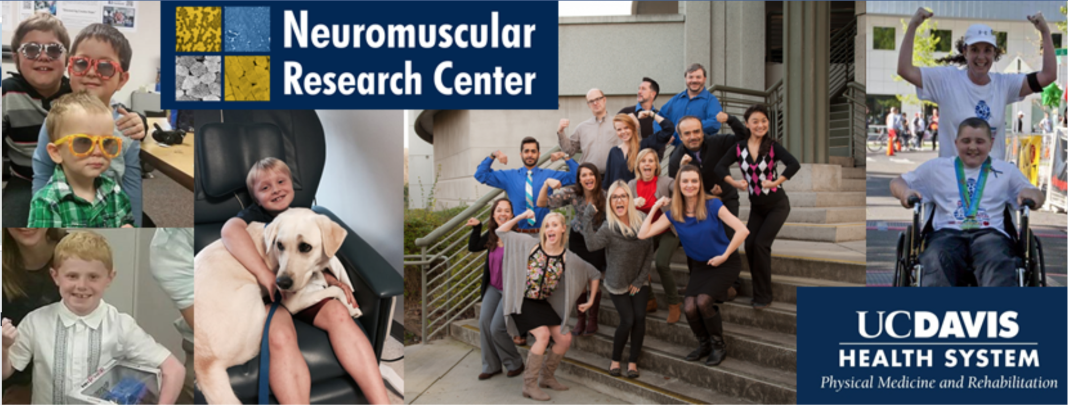
Notes:
And might I add we have many other specialist in our department working together towards our mission. This our neuromuscular research team who work in both the clinical setting and research lab who are the wheels that help us bring emerging bench-work research to the clinic setting (as Dr. Day has elaborated on earlier).
We pursue our mission through the compassionate delivery of the highest quality patient care, state-of-the-art education of students, physicians, clinical investigators and allied health providers, public service to the local and global community, and research which generates new knowledge that can be applied to the health and functional challenges that face our world

Slide 5
Natural History Studies
Development of clinical outcome measurement tools
Clinical trials
Notes:
In the past two decades we have experienced a rapid evolution in our understanding of the molecular and biological basis of many pediatric and adult neuromuscular diseases.
As a result, there has been an increased need to understand disease natural history and to develop assessment methodology to support design of intervention-focused clinical trials to develop cutting edge treatment to maximize function in neuromuscular disease.
.
Our work has focused in four main areas, including development of assessments for clinical trials, conduct of “bench-to-bedside” translational research, epidemiologic “natural history” studies of neuromuscular disease, and assessment of community mobility.

Slide 6
Research
Kinect
Outcome Measures
Clinical Trials
Acceleron
Patient
Disease Treatment
Management Strategies
Disease-Related Condition Management
Pain Management
Bracing and Equipment Needs
Family and Care giver support
Notes:
Although clinical trials to find cures for neuromuscular diseases are important and the often the mission and focus of many health systems and government programs such as the NIH, Developing clinical and patient-reported outcome measures for use in clinical trials, I would argue are just as important.

Slide 7
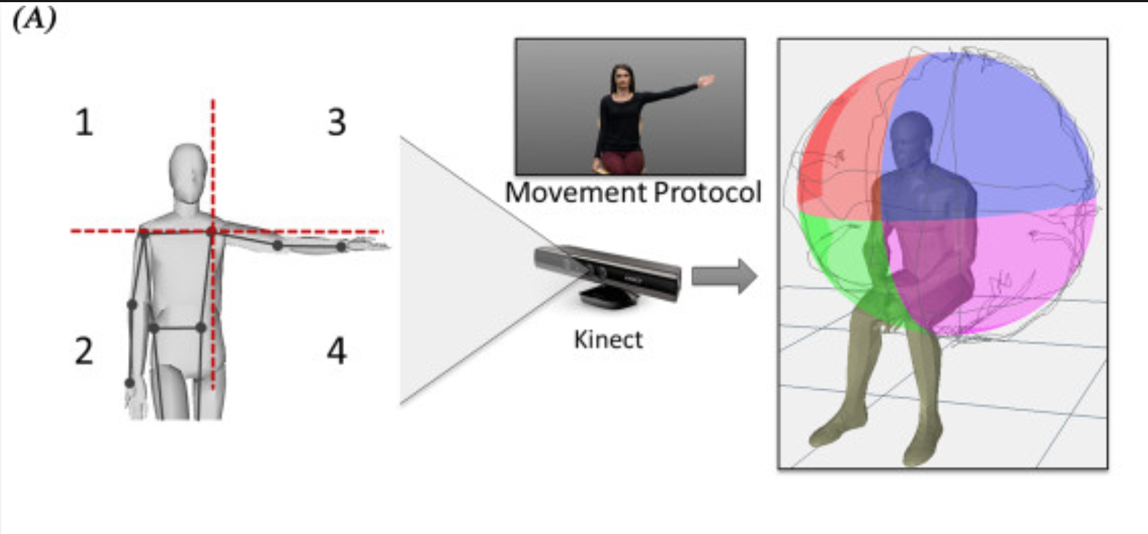
Notes:
Our Neuromuscular research department at UC Davis, has developed a novel outcome measurement tool for measuring upper limb reachable workspace for use in clinical trials and beyond. This project was pioneered by Dr. Jay Han who is now at UC Irvine, in conjunction with the UC Berkeley bioengineering department.
The Kinect technology stems from the microsoft x-box technology used in game consoles for gaming and the first generation of kinect was developed in 2010.
The Kinect technology is a depth-ranging sensor that analyses motion and can be used to determine upper extremity motion to determine the spectrum of reachable workspace encountered in facioscapulohumeral muscular dystrophy (FSHD).
Many of our clinical outcome measurement tools have been focused on isolated strength measurement and ambulation. Prior to this technology we had no way of scientifically measuring the functional reachable workspace which is often affected in FSHD due to involvement of the shoulder girdle.

Slide 8
Kinect

Slide 9
Notes:
With use of the Kinect sensor motion analysis, we are able to determine the total and quadrant reachable workspace relative surface areas (RSAs). These values are normalized by the individual's arm length to determine the reachable workspace.
Reachable workspaces were obtained from 22 individuals with FSHD and 24 age- and height-matched healthy controls. To allow comparison,

Slide 11
Notes:
Significantly contracted reachable workspace and reduced RSAs were noted for the FSHD cohort compared with controls (0.473 ± 0.188 vs. 0.747 ± 0.082; P < 0.0001). With worsening upper extremity function the upper quadrant RSAs decreased progressively, while the lower quadrant RSAs were relatively preserved.
There were no side-to-side differences in reachable workspace based on hand-dominance.
as categorized by the FSHD evaluation subscale II + III,

Slide 12
Notes:
This study demonstrates the feasibility and potential of using an innovative Kinect-based reachable workspace outcome measure in FSHD both clinically and in clinical research trials.

Slide 13
Research
Kinect
Outcome Measures
Clinical Trials
Acceleron
Patient
Disease Treatment
Management Strategies
Disease-Related Condition Management
Pain Management
Bracing and Equipment Needs
Family and Care giver support
Notes:
Cutting edge treatment to maximize functions.
There are no FDA approved therapies for FSHD, one of the most common muscular dystrophies, and current management focuses on physical and occupational therapy, bracing and supportive durable medical equipment as well as certain surgical interventions.
Recent efforts to develop treatment for FSHD include agents that target the genetic mechanism producing FSHD as well as several promising pharmacologic compounds (including selective androgen receptor modulators, myostatin inhibitors, and troponin activators) that aim to promote muscle growth, reduce muscle degeneration, and/or improve skeletal muscle function.

Slide 14
World’s strongest baby
Notes:
I would like to introduce to you the World’s strongest baby.
At first glance, this baby may look normal baby but he is in fact a Superman, or superbaby. You can see her that he has bulging arm and leg muscles. He has muscles twice the size of other kids his age and half their body fat. In short, he's strong as a bull. The miraculous discovery here was that he had an inherited myostatin-related muscle hypertrophy. A genetic mutation which prevents the muscle cell from breaking down resulting in muscle growth and muscle differentiation.
Mutations in the myostatin gene have been shown to result in dramatic increase in muscle mass in multiple species.

Slide 15
Acceleron/ACE-083: Physiologic mechanism:
Myostatin is a protein produced and released by myocytes (also known as a muscle cell) which inhibits muscle cell growth and differentiation (myogenesis)
ACE-083 binds to and inhibits select proteins that negatively regulate (reduce) muscle growth, such as Myostatin (also known as growth differentiation factor 8, abbreviated GDF-8)

Slide 16
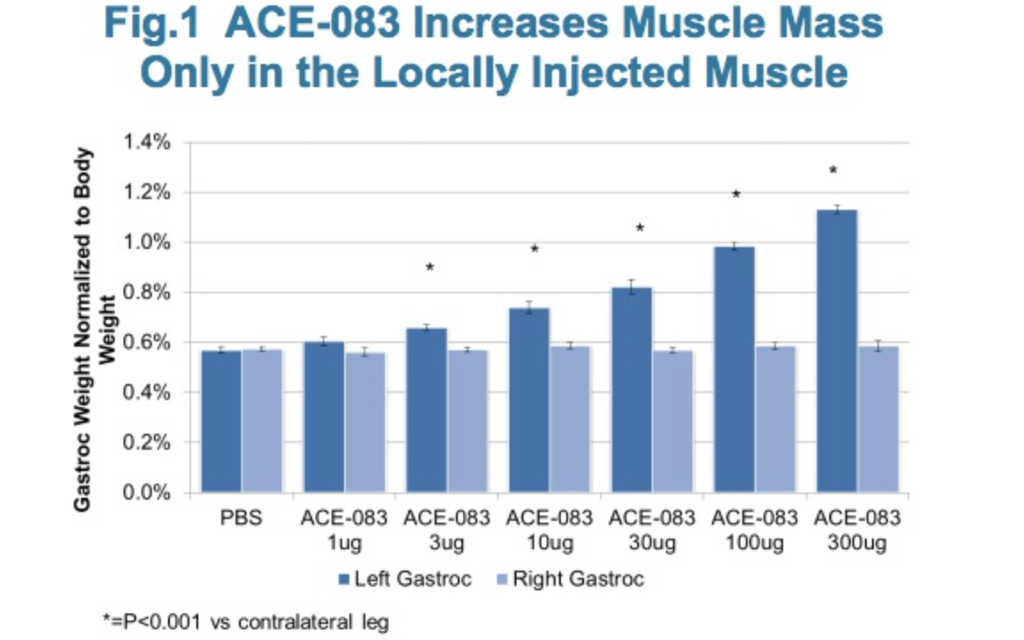
Acceleron: ACE-083

Slide 17
Acceleron: ACE-083
“Pioneering therapy to increase muscle strength and function in neuromuscular diseases”
ACE-083 is a locally active agent that may be useful for focal muscle loss such as in FSHD.
Designed to increase strength and function in targeted muscles
Thought to improve patient function and quality of life

Slide 18
Acceleron: ACE-083
First indication of ACE-083 has been targeted for FSHD
Notes:
This study is being recruited in phases. The first couple of phases have been completed and we will be looking for patients for the next phase.
We are currently recruiting
A Phase 2 Randomized, Double-Blind, Placebo-Controlled Study of ACE-083 in Patients With Facioscapulohumeral Muscular Dystrophy

Slide 19
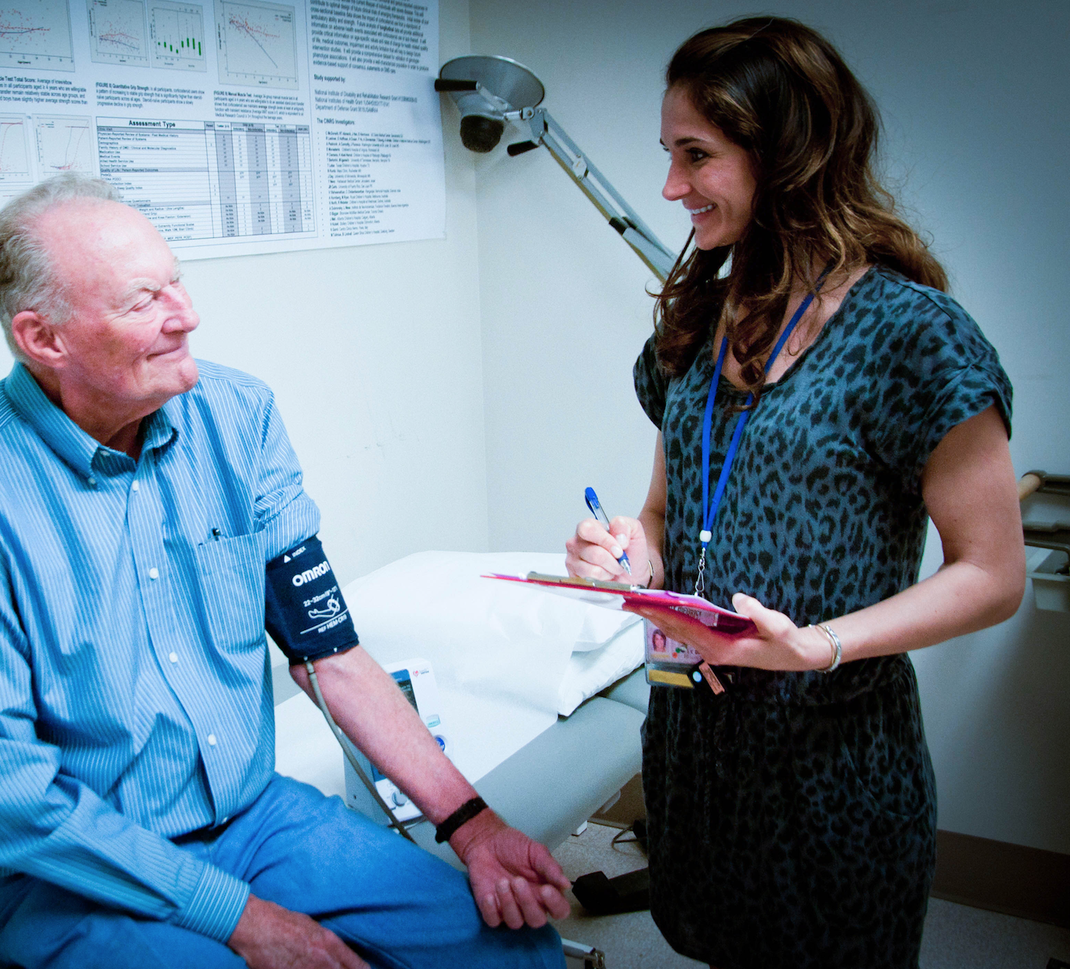
UC Davis Health is apart of the multi-center Acceleron/ACE-083 trial
Focal - Looking at the biceps and tibialis anterior
Drug has appeared to be safe and tolerable in patients
Notes:
We do not have data for the trial to talk about.

Slide 20
Notes:
Again, here we have our neuromuscular research team at UC Davis.

Slide 21
Notes:
Here we have the entrance to our NMD clinics and research lab at UC Davis at the LE ACC building and I hope after this talk you can realize that our focus and mission can be summed up in this slogan here “discovery creates hope”

Slide 22
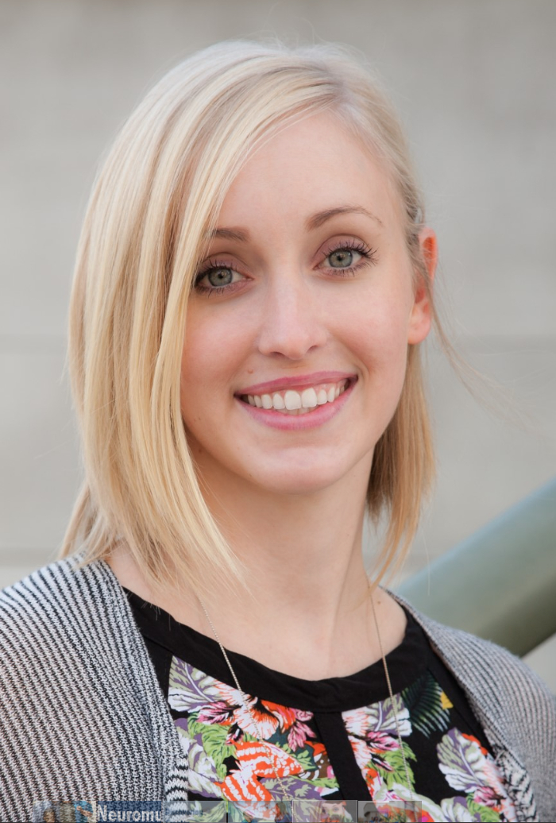
FSHD Acceleron (ACE-083) Contact
Colleen Anthonisen, CCRP
Clinical Research Coordinator / Clinical Evaluator
Neuromuscular Research Center
Department of Physical Medicine & Rehabilitation Phone: 916-734-4307
Fax: 916-734-6199
Pager: 916-816-3080 4860 Y St. Suite 3850 Sacramento, CA 95817

Slide 23
https://www.facebook.com/UCDavisPMR/
http://www.ucdmc.ucdavis.edu/pmr/patient_services/clinic/neuromuscular.html

Slide 24
References:
1. Han JJ, Kurillo G, Abresch RT, de Bie E, Nicorici A, Bajcsy R. Reachable workspace in facioscapulohumeral muscular dystrophy (FSHD) by Kinect. Muscle & nerve. 2015;51(2):168-175.
http://acceleronpharma.com/product-candidates/ace-083/
https://www.clinicaltrials.gov/ct2/show/NCT02927080?cond=fshd&draw=1&rank=6

