Slide 1
FSHD 101
4/28/2019
Jacinda Sampson MD PhD
Neurogenetics

Slide 2
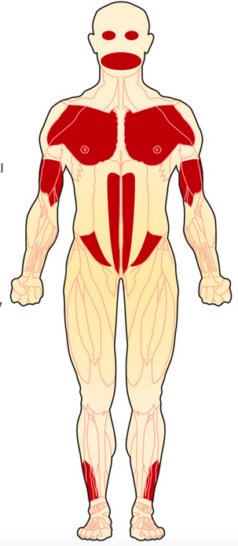
Facioscapulohumeral muscular dystrophy: More than muscles
MDA.org
Facio-
face
Scapulo-
shoulder
Humeral-
upper arm
- does not describe all the muscles affected!
Abdomen
Ankles
But, other systems can also be affected
asymmetric
stepwise
Tawil et al Neurology 2015;85:357–364

Slide 3
Eyes
Eye closure weakness
notable when asleep
symptoms of red, irritated eyes
increased tearing/
crusting of eyelashes
blink protection decreased
to injury, abrasion.
Lid weakness- inversion of eyelashes
Lead to exposure keratopathy
Damage to corneas
Monitoring: screening by
ophthalmologist
Mul K, et al. Pract Neurol 2016;16:201–207
https://www.fshsociety.org

Slide 4
Eyes
Management:
Avoid: eyedrops with vasoconstricting
Ingredients
i.e. NOT “get the red out” type
Try: humidifier
eyedrops
natural tears type
eye gel or ointment at night
consider an eye guard
Oculoplastic surgery
https://www.fshsociety.org

Slide 5
Retina- Coat’s disease
Coat’s disease
occurs in 0.8% of people with FSHD
Retinal vascular changes
occur in about 25% of people with FSHD
What is exudative retinopathy?
Affects blood vessels of retina
Microaneurysms
Leakage of vessels
Retinal detachment
Monitoring: screening by ophthalmologist
Management: laser treatment, surgery
Williams, Retina, the J of Retinal and Vitreous Dis. 2019
Lee et al. J AAPOS 2014;18:303-305.
Statland et al. Neurology 2013;80:1247–1250

Slide 6
Hearing impairment: childhood onset
Affects approximately 15% overall
32% of people with large deletions
High frequencies affected
Might not be detected on newborn hearing screen
Can be progressive
Monitoring: audiology screening
childhood onset FSHD
Management:
Hearing aides
Individualized educational plan
Lutz et al Neurology" 2013;81:1374–1377

Slide 7
Cardiac
No evidence of increased risk of cardiomyopathy
No clear increased risk of arrhythmia
Not excluded from the usual risk factors of the general population!
Monitoring: health care prevention monitoring
Management: (if present)
hypertension
hypercholesterolemia
diabetes
avoid smoking
Tawil et al Neurology 2015;85:357–364

Slide 8
Pulmonary
Found to be reduced in
41% of people w/ FSHD
Often first noticed
as sleep disordered
Breathing
Or when lying flat
Monitoring: Check spirometry
(lung function)
--at baseline
-- followup visits
Treatment: non-invasive ventilation (NIV)
Wikibooks, Anatomy and Physiology of Animals/Respiratory System
Moreira et al. J Neurol (2017) 264:1271–1280

Slide 9
Fatigue
““Fatigue is a subjective, unpleasant symptom which incorporates total body feelings ranging from tiredness to exhaustion, creating an unrelenting overall condition which interferes with individuals’ ability to function to their normal capacity”
physical/neuromuscular
emotional
cognitive
Reported by 61% of people w/ FSHD, significant impact on quality of life
affect mood, stress
limitations in activities (social, professional)
Monitoring: talk with your doctor, physical therapist, social worker
identify manageable factors
Treatment: physical therapy, adaptive strategies
Schipper et al, Disability and Rehabilitation, 39:18, 1840-1846

Slide 10
Pain
Pain is common in FSHD
89-97% of adults reported pain
(15-20% controls)
Example:
93% reported shoulder pain
63% leg pain
43% lower back pain
Often chronic (55%)
Affecting quality of life
Jaques et al, PLoS ONE 14(2): e0212437
Moris et al. Muscle Nerve 57: 380–387, 2018

Slide 11
Pain
Monitoring:
Discuss with your physician and physical therapist
Non-pharmacologic Management:
Postural support
Stretching
Physical therapy– stay tuned for Tina Duong’s presentation
Sufficient sleep
Medical management:
nonsteroidal anti-inflammatories
ex: ibuprofen, naproxen, celecoxib
antidepressants
imipramine, amitriptyline
duloxetine
antiepileptic medications
gabapentin, pregabalin
avoid or minimize opiates
no research published on CBD or medical cannabis

Slide 12
FSHD 101- Conclusion
FSHD is a multisystemic disorder:
not only involving muscles
Important to follow regularly with your care team
physicians and therapists
Management is:
Preventative
Supportive
Adaptive
Proactive

Slide 14
References

