Slide 1
Speech-Language Pathology and FSHD: Addressing Communication and Swallowing Issues
Sarah C. Stranberg, MA, CCC-SLP
Speech-Language Pathologist, Outpatient Neurorehabilitation
Stanford Health Care
April 28, 2019
Notes:
Part of rehab team with PT and OT

Slide 2
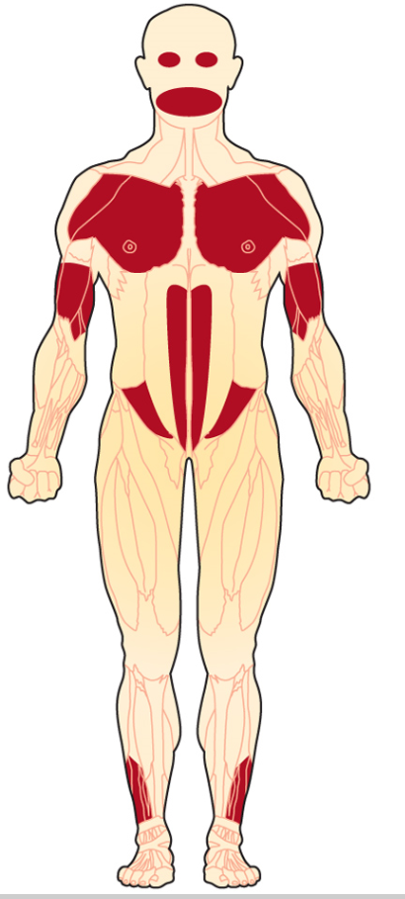
FSHD
Obicularis
Oculi
Asymmetrical facial weakness
Typically affecting the circular muscles around the eyes and mouth
Range of severity
Alteration in facial expression
Can affect activities that require lip strength
Drinking through a straw
Whistling
Smiling
Speech/swallowing (25-35% of pts)
Zygomaticus Major
Obicularis Oris
www.med.stanford.edu/ohns/healthcare/facialnervecenter.html
www.mda.org

Slide 3
Communication issues with FSHD
Speech
Weakness of lips affecting articulation (sounds such as p, b, m, f, v)
Facial expression
Reduced facial expression
Mismatch between facial expression and content of verbal message
Gestures
Voice
Reduced breath support for speech
Can affect quality and intensity (volume) of voice
Treatment
Compensatory speech strategies (slowing rate, over-articulating)
Using prosody/tone to express emotion
Maximizing breath support for speech
AAC (Alternative and Augmentative Communication): using devices, voice amplifiers

Slide 4
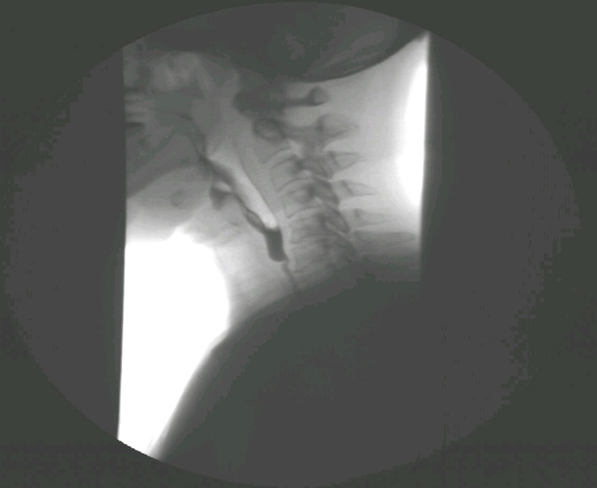
Swallowing issues with FSHD
Disorders of swallowing= dysphagia
Complex mechanism involving dozens of muscles
Dysphagia in FSHD
Anterior loss
Difficulty with oral phas
Oral residue after swallow
Evaluation of dysphagia
Clinical swallowing evaluation
Formal swallowing assessments
Treatment
Diet modifications
Safe swallowing strategies
Adaptive utensils/cups
Positioning
Notes:
Phases of swallowing
oral
pharyngeal
esophageal
Affects safety and/or efficiency with oral intake
Consequences
aspiration pneumonia---possible death
airway obstruction
malnutrition
dehydration
inability to sustain with oral intake
Limited research on FSHD
Findings of tongue atrophy or weakness
Other
Exercises
Respiratory strength training

