Slide 1
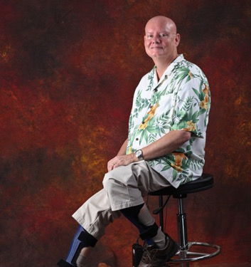
2O24 FSHD Connect
Managing and Reducing FSHD Pain
Kurt Spiegel

Slide 2
Managing and
Reducing
FSHD
Pain

Slide 3
Where we are
Studies have found that between 55% and 89% of people with FSHD experience chronic pain
The Research:
MD, PhD, PT, AARP, PT, PsyD, self experimentation, peer review
My Title:
FSHD Pain Analyst

Slide 4
Understanding FSHD Pain
Facioscapulohumeral muscular dystrophy (FSHD) is a neuromuscular disorder
Nerve Pain
Peripheral nervous system
Branches out from the brain and spinal cord
Often described as burning, pins & needles, stabbing
Muscle Pain
Weakened or atrophied muscles
Compensating muscles are over worked
Often described as sore, aching

Slide 5
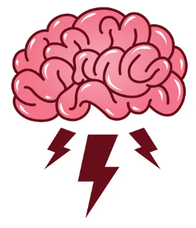
Understanding FSHD Pain – The mind
Chronic Pain can be amplified in the brain
The brain can generate pain completely on it’s own
Stress will make your pain worse
The brain processes emotions and your body’s happiness messengers (dopamine, endorphins, oxytocin, and serotonin) naturally decrease pain
Mindfulness is the ability to be fully aware and not to get overwhelmed by what’s happening to you.

Slide 6
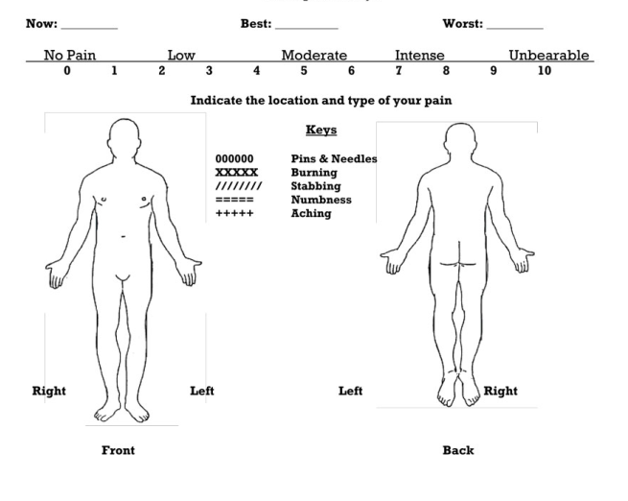
Methodology for Pain Mitigation - Start
Note current pain levels
Focus on highest level pain
Search for causes of:
- inflammation
- physical stress
- mental stress
Ensure you are working with your body and providing proper nutrition and getting quality sleep!

Slide 7
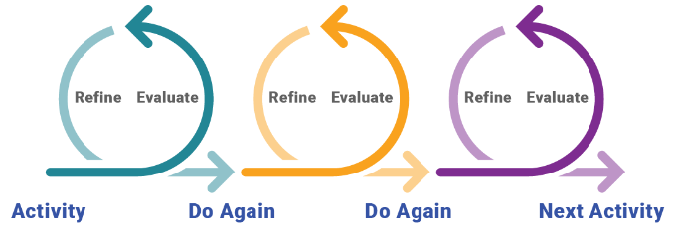
Methodology for Pain Mitigation – Iterate!
Note current pain levels
Focus on highest level pain
Note changes to reduce:
- inflammation
- physical stress
- mental stress
Pick one mental or physical solution from the resource list and follow due course to evaluate effectiveness
If the solution is working, incorporate it into your repertoire

Slide 8
Potential Solutions - Mind
Become Mindful
Guided Imagery
Go to your happy place
Pleasant Activity Scheduling
Music is emotional medicine
Social Connections
Paced Breathing/Meditation

Slide 9
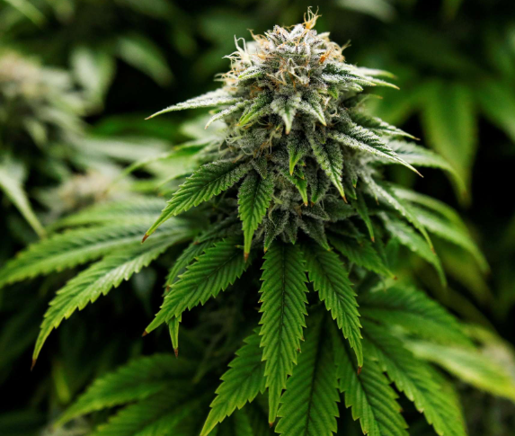
Potential Solutions – Marijuana
Key Active Ingredients
THC = psychoactive which will get you “high”
CBD = Non psychoactive
Strains
Indica = Calming
Sativa = Energizing

Slide 10
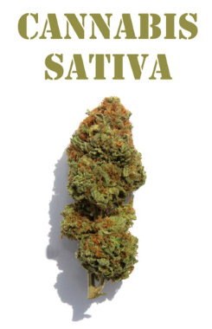
Potential Solutions – Marijuana targeted solution
CBD can reduce
Anxiety
Inflammation
Nerve-related pain
THC can reduce
Chronic pain or nerve pain
Muscle stiffness

Slide 11
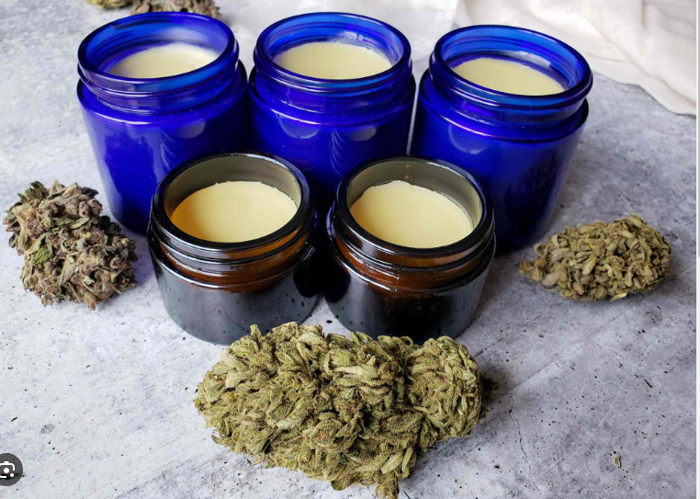
Potential Solutions – Marijuana targeted solution
Smoke
Will get you high
Irritant to eyes, nose, lungs
Edibles
Will get you high
Effects are difficult to manage
Salve
Does not enter the bloodstream and will not get you high

Slide 12
Potential Solutions - Mind/Body
Qigong
Regulate mind, breath, and body
Paced Breathing
Increases calming parasympathetic activity
Happy Hour
Reduces social isolation

Slide 13
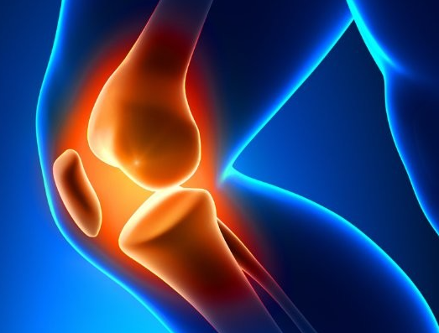
Potential Solutions - Body
Arthritis Pain Relief Gel – Diclofenac Sodium
Marijuana Salve
Massage
Chiropractor
PT
Trigger Point Therapy
Hot Springs/Hot Tub

Slide 14
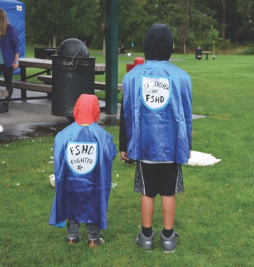
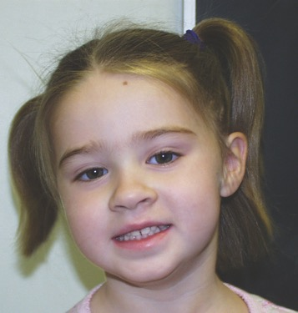
THANK
YOU!

